Slide 1
Introduction to Android Development Environment
ECOD - Aug 2015

Slide 2








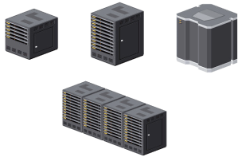
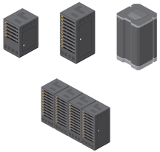

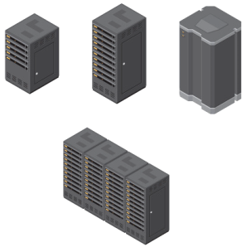
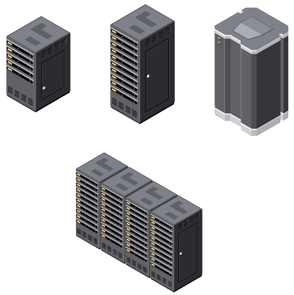











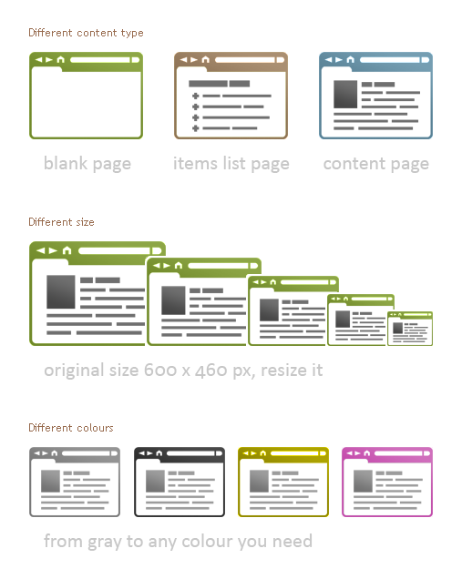


Mobile-Cloud = bringing the combined power of CAMSS
Customer’s energy around CAMSS is not driven by 5 distinct parallel agendas
Combining CAMSS in tandem delivers agility to create new business opportunities
API-centric approach enable CAMSS to be rapidly composed as building blocks
C
+
A
+
M
+
S
+
S
Hybrid cloud
Real-time big data analytics
Mobile &
Internet of Things
Social Engagement
Perimeter Security
SaaS
API
API
API
API
API
API
API
e.g. Developer composes new app to address requirement from CMO
Mobile app drives increased retail sales by analysis (SaaS) of purchase history (on prem), shopping basket (cloud) and preferences of social circle and sends secure personalised offers based on proximity to stores and vending machines (Internet of Things)

Slide 3
What is Android?
A software stack for mobile devices that includes
An operating system
Middleware
Key Applications
Uses Linux to provide core system services
Security
Memory management
Process management
Power management
Hardware drivers

Slide 4
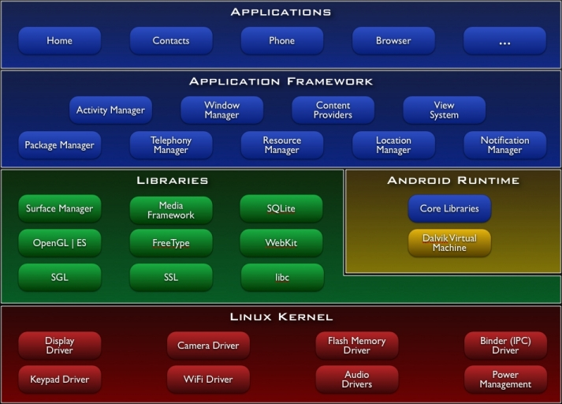
http://developer.android.com/guide/basics/what-is-android.html

Slide 5
Android Features
Application framework enabling reuse and replacement of components
Dalvik virtual machine optimized for mobile devices
Integrated browser based on the open source WebKit engine
Optimized graphics powered by a custom 2D graphics library; 3D graphics based on the OpenGL ES 1.0 specification (hardware acceleration optional)
SQLite for structured data storage
Media support for common audio, video, and still image formats (MPEG4, H.264, MP3, AAC, AMR, JPG, PNG, GIF)
GSM Telephony (hardware dependent)
Bluetooth, EDGE, 3G, and WiFi (hardware dependent)
Camera, GPS, compass, and accelerometer (hardware dependent)
Rich development environment including a device emulator, tools for debugging, memory and performance profiling, and a plugin for the Eclipse IDE
http://developer.android.com/guide/basics/what-is-android.html

Slide 6
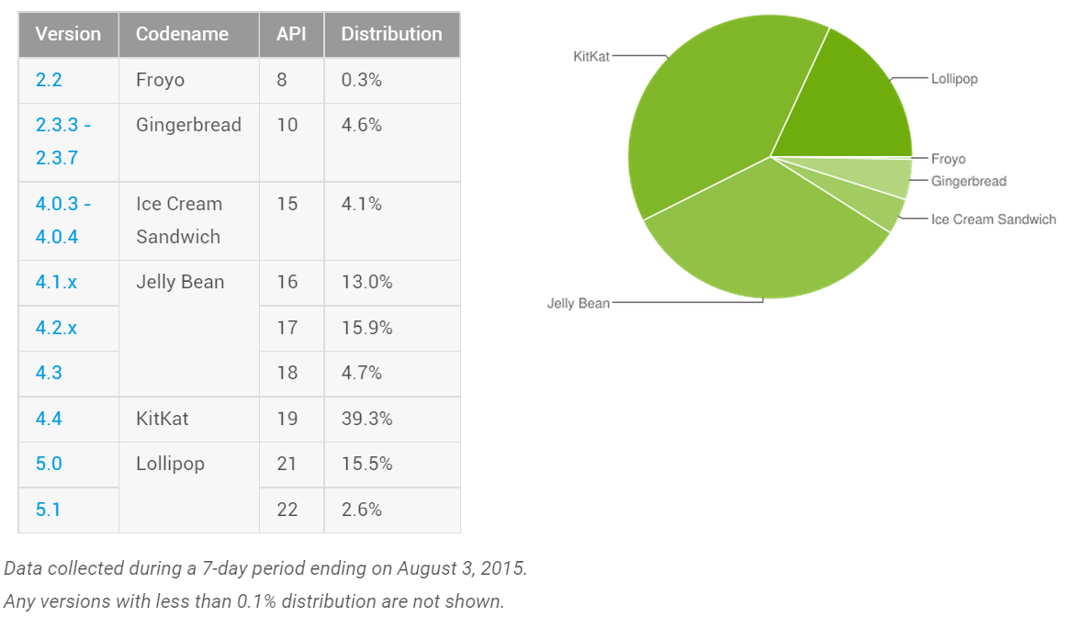
Android Distribution Aug 2015
https://developer.android.com/about/dashboards/index.html

Slide 7
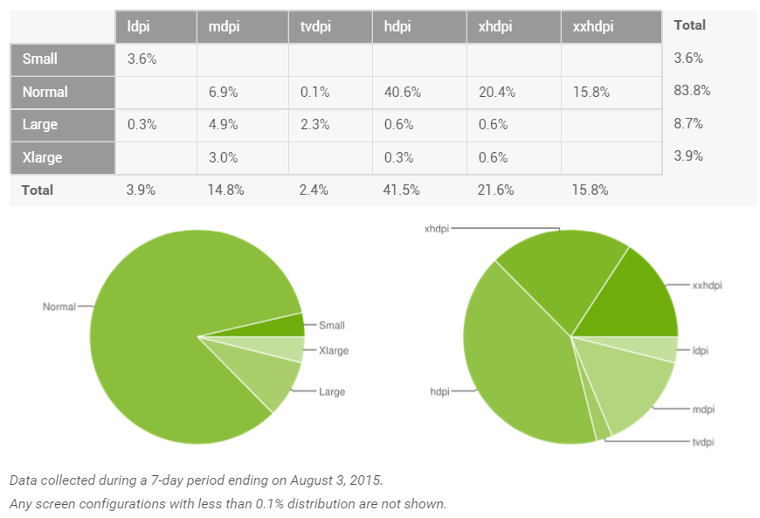
Screen Densities as of August 2015
~120dpi ~160dpi ~240dpi ~320dpi ~480dpi ~640dpi

Slide 8
Android Runtime

Slide 9
Android Runtime: Dalvik VM
Subset of Java developed by Google
Optimized for mobile devices (better memory management, battery utilization, etc.)
Dalvik runs .dex files that are compiled from .class files
Introduces new libraries
Does not support some Java libraries like AWT, Swing
http://developer.android.com/reference/packages.html

Slide 10
Applications Are Boxed
By default, each app is run in its own Linux process
Process started when app’s code needs to be executed
Threads can be started to handle time-consuming operations
Each process has its own Dalvik VM
By default, each app is assigned unique Linux ID
Permissions are set so app’s files are only visible to that app

Slide 11

Producing an Android App
Java code
javac
Byte code
Dalvik exe
dx
.java
.class
classes.dex
aapt
Byte code
<xml>
Other .class files
AndroidManifest.xml
.apk
<str>
Resources
Notes:
Every application must have an AndroidManifest.xml file (with precisely that name) in its root directory. The manifest presents essential information about the application to the Android system, information the system must have before it can run any of the application's code. Among other things, the manifest does the following:
It names the Java package for the application. The package name serves as a unique identifier for the application.
It describes the components of the application — the activities, services, broadcast receivers, and content providers that the application is composed of. It names the classes that implement each of the components and publishes their capabilities (for example, which Intent messages they can handle). These declarations let the Android system know what the components are and under what conditions they can be launched.
It determines which processes will host application components.
It declares which permissions the application must have in order to access protected parts of the API and interact with other applications.
It also declares the permissions that others are required to have in order to interact with the application's components.
It lists the Instrumentation classes that provide profiling and other information as the application is running. These declarations are present in the manifest only while the application is being developed and tested; they're removed before the application is published.
It declares the minimum level of the Android API that the application requires.
It lists the libraries that the application must be linked against.

Slide 12
Emulator

Slide 13
Emulator Basics
Host computer’s keyboard works
Host’s mouse acts as finger
Uses host’s Internet connection
Other buttons work: Home, Menu, Back, Search, volume up and down, etc.
Ctrl-F11 toggle landscape → portrait
Alt-Enter toggle full-screen mode
More info at http://developer.android.com/guide/developing/devices/emulator.html

Slide 14
Emulator Limitations
No support for placing or receiving actual phone calls
Simulate phone calls (placed and received) through the emulator console
No support for USB connections
No support for camera/video capture (input)
No support for device-attached headphones
No support for determining connected state
No support for determining battery charge level and AC charging state
No support for determining SD card insert/eject
No support for Bluetooth
No support for simulating the accelerometer
Use OpenIntents’s Sensor Simulator

Slide 15
Android Emulator or AVD
Emulator is essential to testing app but is not a substitute for a real device
Emulators are Android Virtual Devices (AVDs)
Android SDK and AVD Manager allows you to create AVDs that target any Android API level
AVD have configurable resolutions, RAM, SD cards, skins, and other hardware

Slide 16

Creating Hello World App
Live Lab
Create an Activity
Demonstrate resources created
show the Activity lifecycle within the Android OS
show the various debugging tools available
show how to start one Activity from another

Slide 17
Pre-Req for Mobile Lab
Ensure the AVD and DSK are confugired well

Slide 18
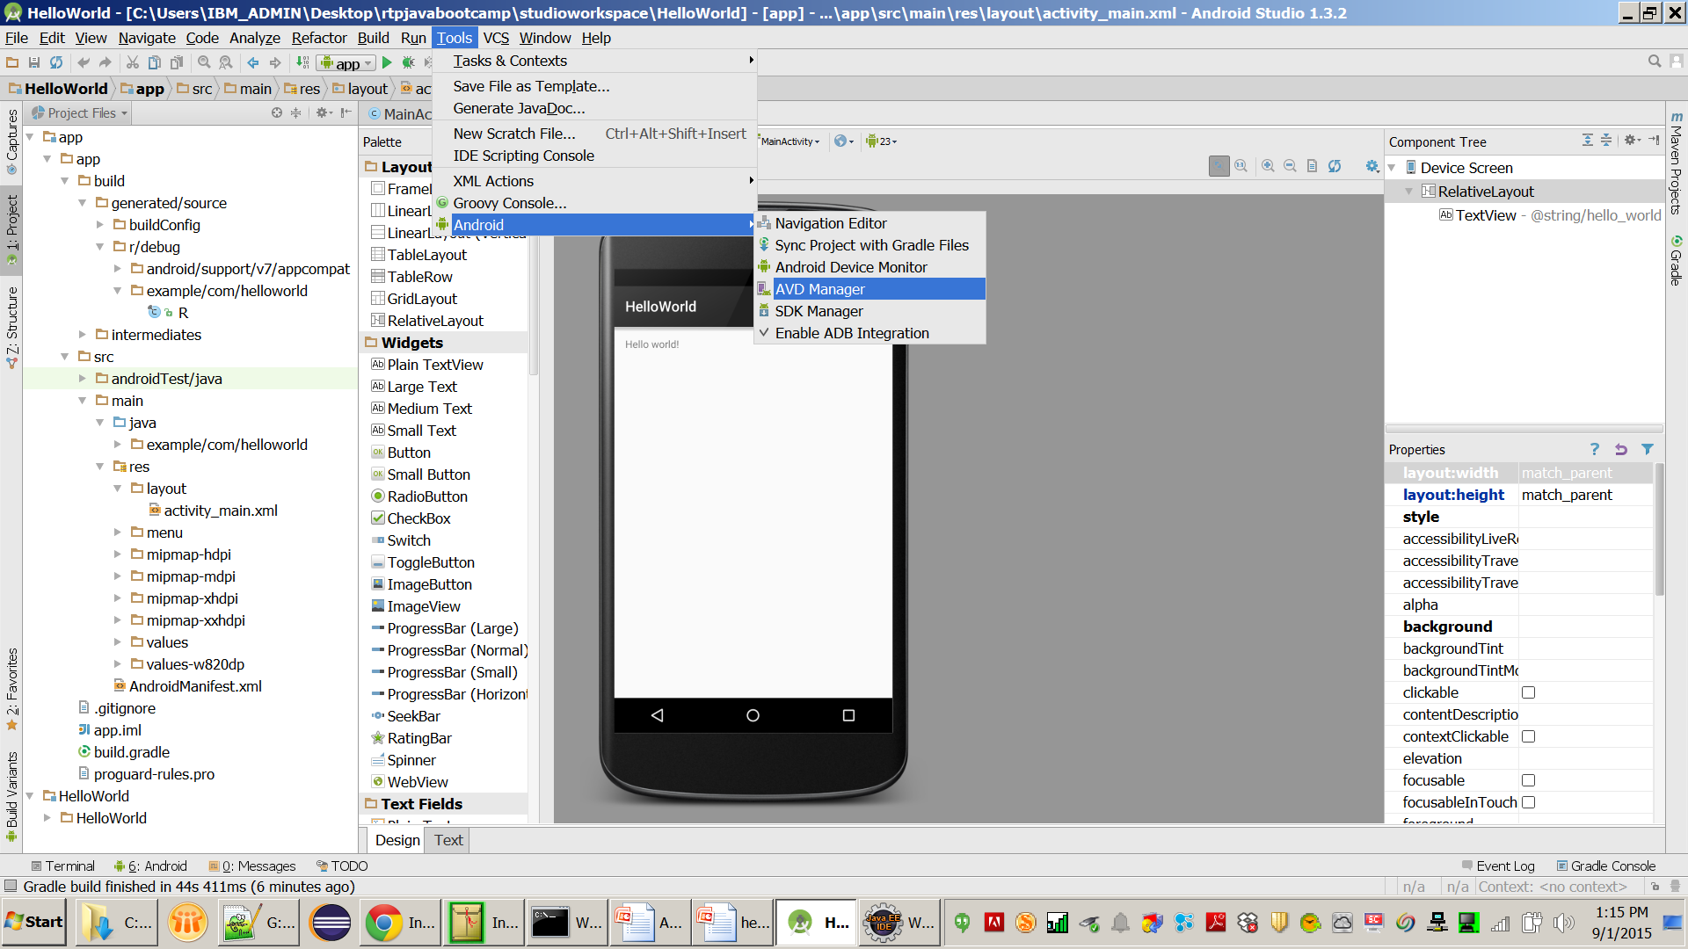

Slide 19
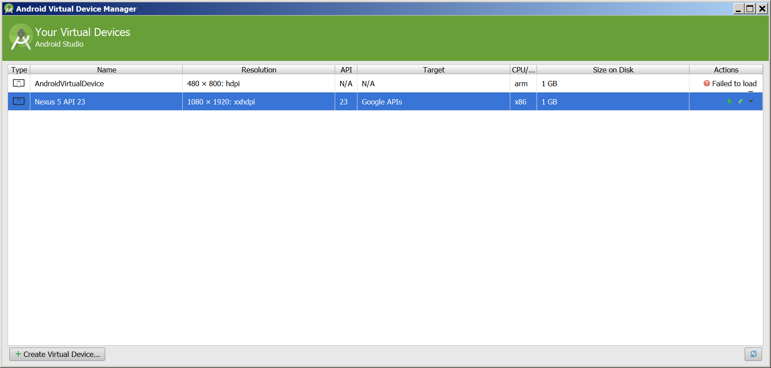

Slide 20
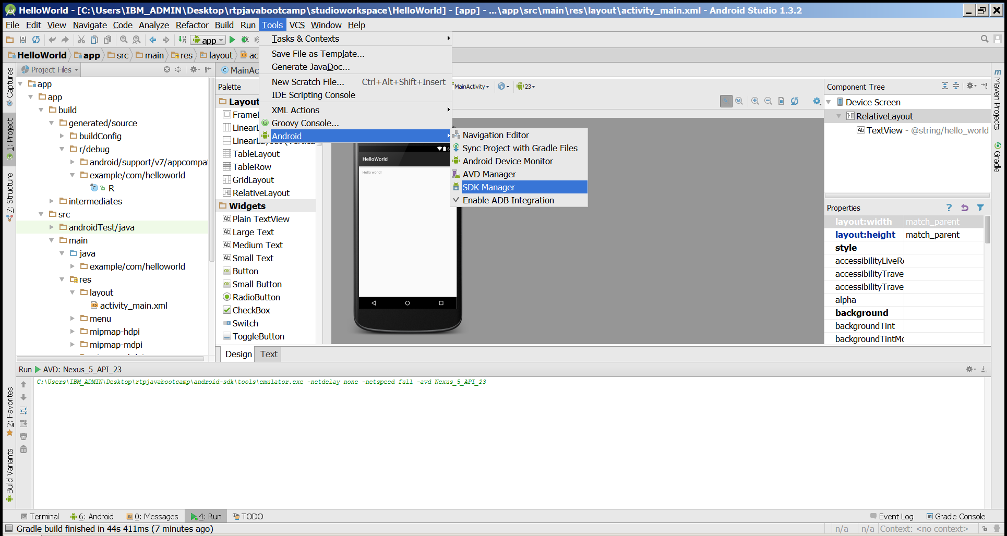

Slide 21
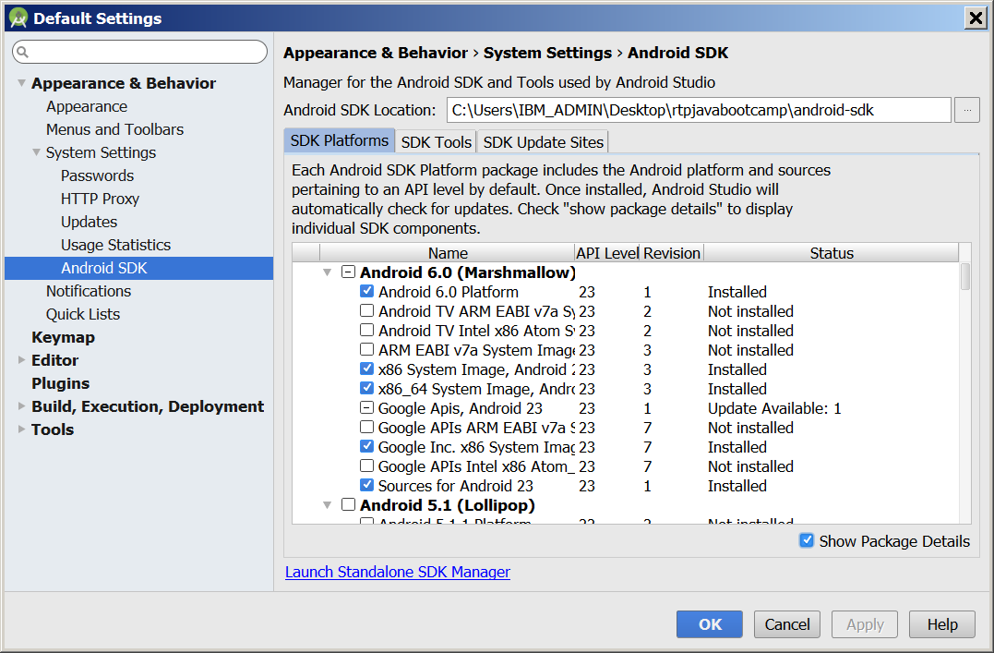

Slide 22
Mobile Labs
1-7

Slide 23
Lab 1
Getting Hello World App Running

Slide 24
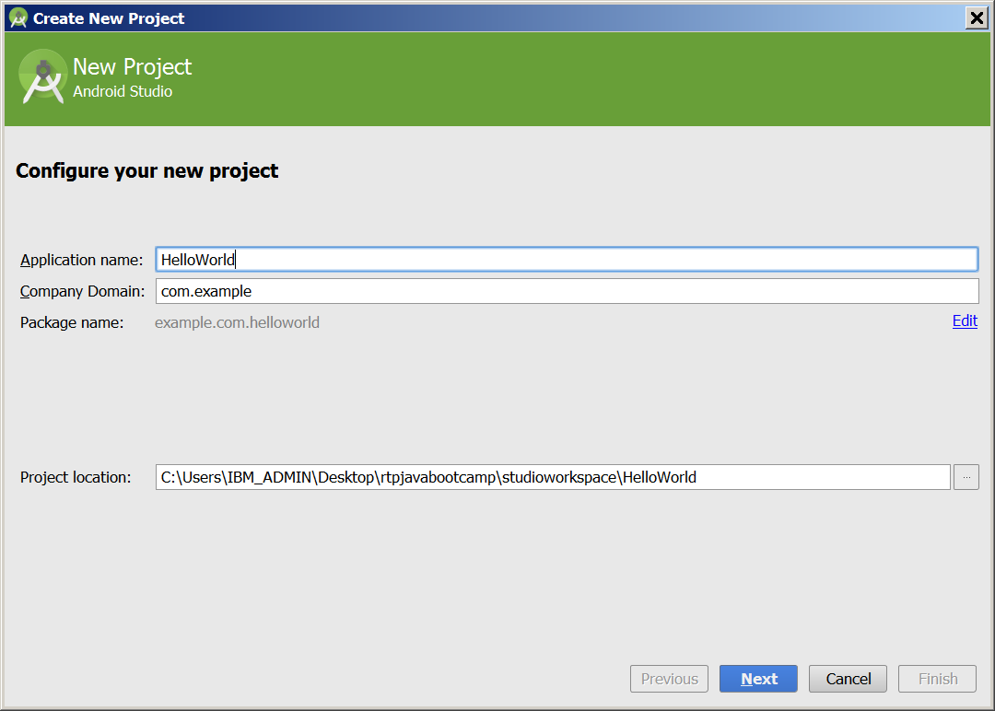

Slide 25
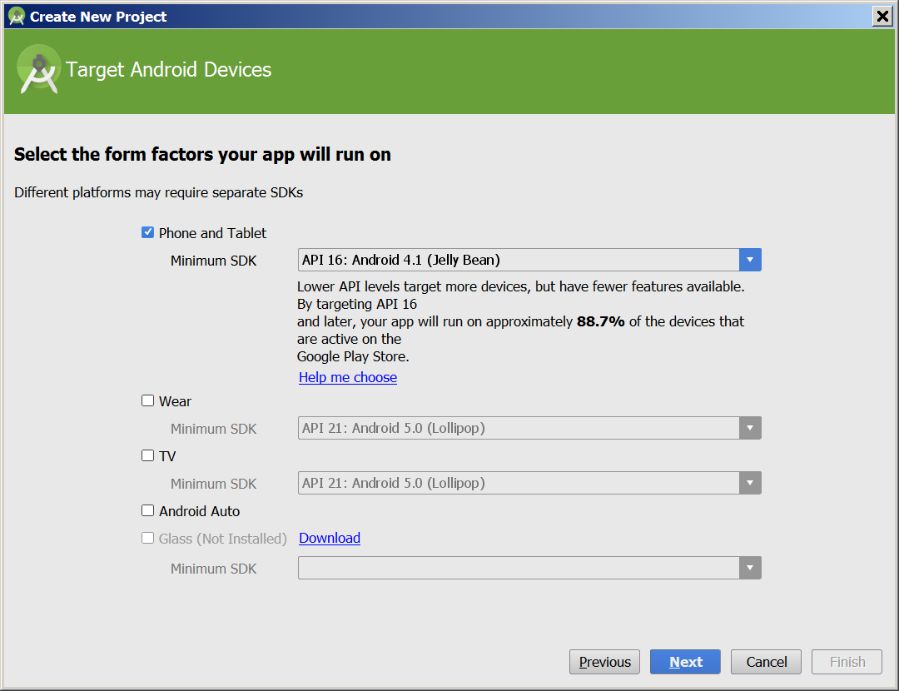

Slide 26
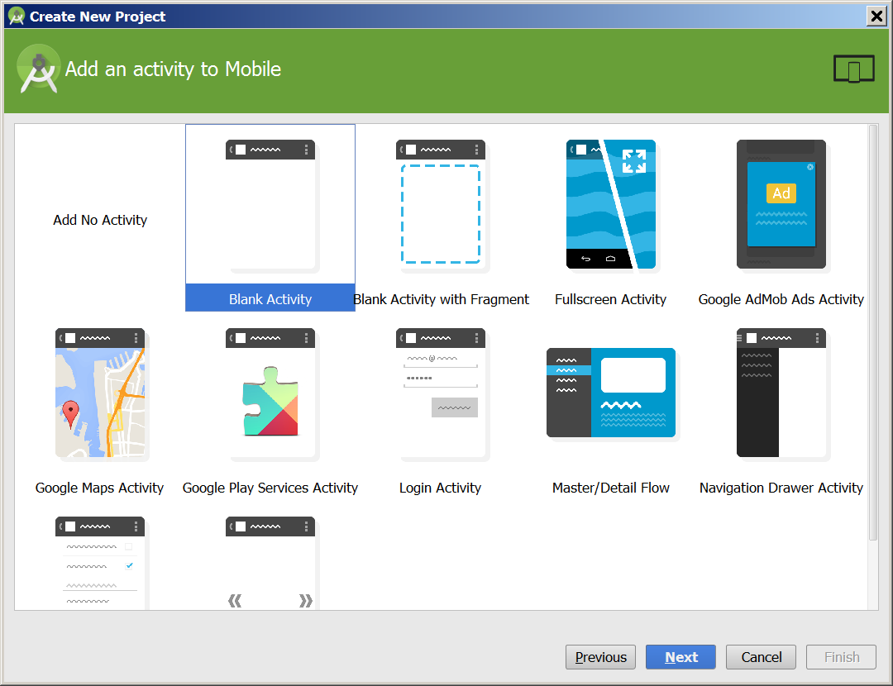

Slide 27
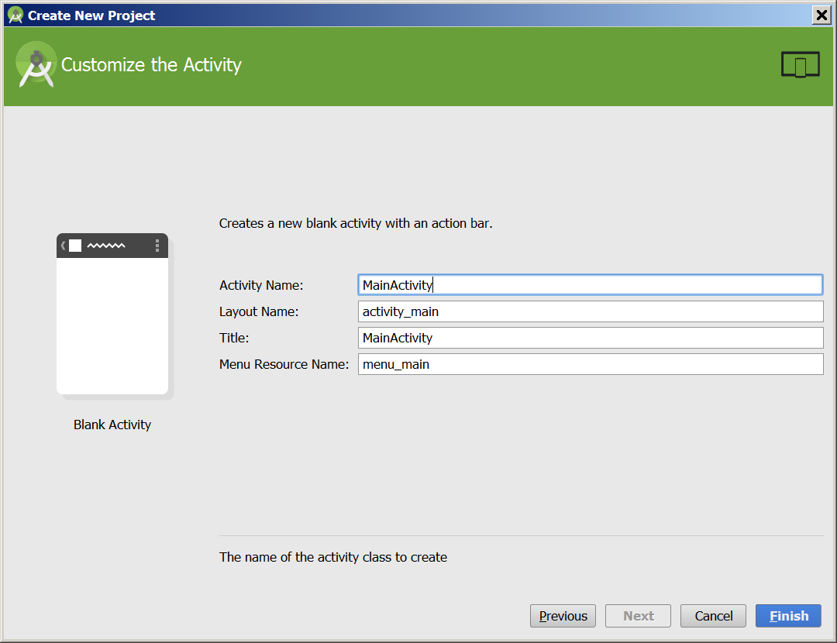

Slide 28
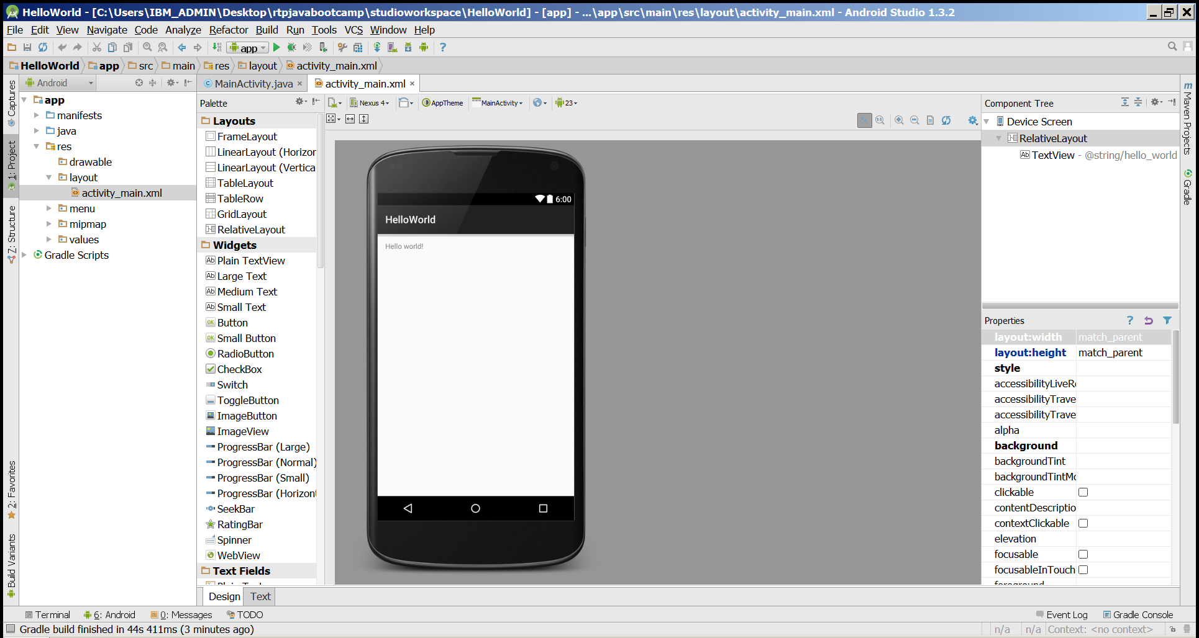
Ready to Launch !

Slide 29
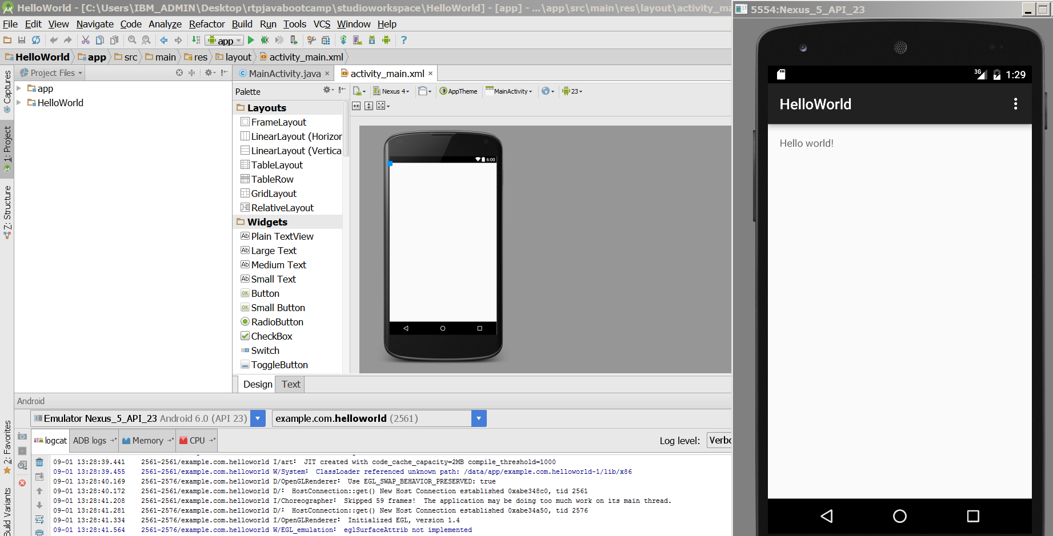
Hurray !

Slide 30
Lab 2
Add some Code to onCreate method

Slide 31
Application Components List
five primary components - different purposes
Activity
single screen with a user interface, app may have several activities, subclass of Activity
Most of early examples will be activities
Intents
used to pass information between applications
Service
Application component that performs long-running operations in background with no UI
example, an application that automatically responds to texts when driving

Slide 32
Application Components List..contd
Content Providers
a bridge between applications to share data
for example the devices contacts information
we tend to use these, but not create new ones
Broadcast Receivers
component that responds to system wide announcements
battery low, screen off, date changed
also possible to initiate broadcasts from within an application

Slide 33
Understanding Activity Stack

Slide 34
Activity Stack
Most recently created is at Top
Activity 1
User currently interacting with me
Activity 2
Pressing Back or destroying A1 will bring me to the top
Activity 3
Activity N
If Activities above me use too many resources, I’ll be destroyed!

Slide 35
Typical Game
High Scores
Activity
Splash Screen
Activity
Main Menu
Activity
Game Play
Activity
Settings
Activity
Conder & Darcey (2010), Fig 4.1, p. 74

Slide 36
Understanding the Essence of Lifecycle
Necessary to overload callback methods so you app behaves well:
App should not crash if the user receives a phone call or switches to another app while using your app.
App should not consume valuable system resources when the user is not actively using it.
App should not lose the user's progress if they leave your app and return to it at a later time.
App should not crash or lose the user's progress when the screen rotates between landscape and portrait orientation.
http://developer.android.com/training/basics/activity-lifecycle/starting.html

Slide 37
Starting Activities
Android applications don't start with a call to main(String[])
instead a series of callback methods are invoked
each corresponds to specific stage of the Activity / application lifecycle
callback methods also used to tear down Activity / application

Slide 38
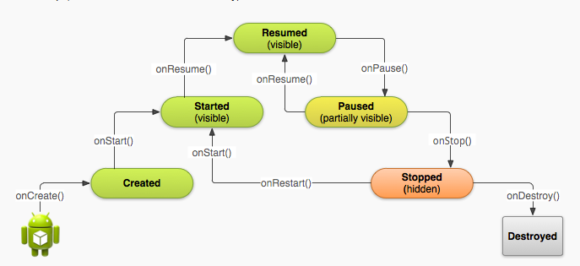
Simplified Lifecycle Diagram
ready to interact with user

Slide 39
Primary States
Active
activity is in the foreground and user can interact with it
Paused
activity partially obscured by another activity and user cannot interact with it (for example when working with a menu or dialog)
Stopped
activity completely hidden and not visible to user. It is in the background.
Activity instance and variables are retained but no code is being executed by the activity
Dead, activity terminated (or never started)
Two other states, Created and Started, but they are transitory onCreate -> onStart -> onResume

Slide 40
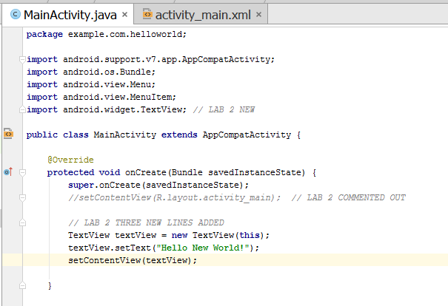
Change MainActivity.java to this

Slide 41
Lab 2 Changes to Lab 1 Code
Add import android.widget.TextView;
In the OnCreate Method
Comment out THIS LINE // setContentView(R.layout.activity_main);
Add the lines
TextView textView = new TextView(this);
textView.setText("Hello New World!");
setContentView(textView);

Slide 42
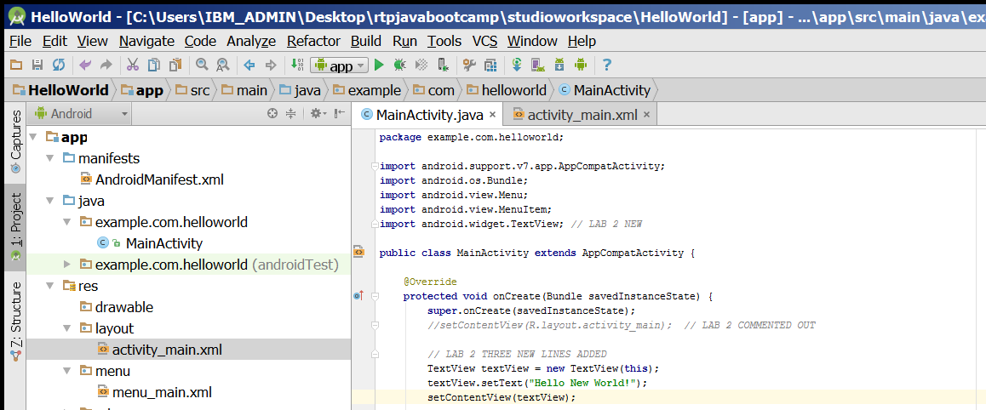
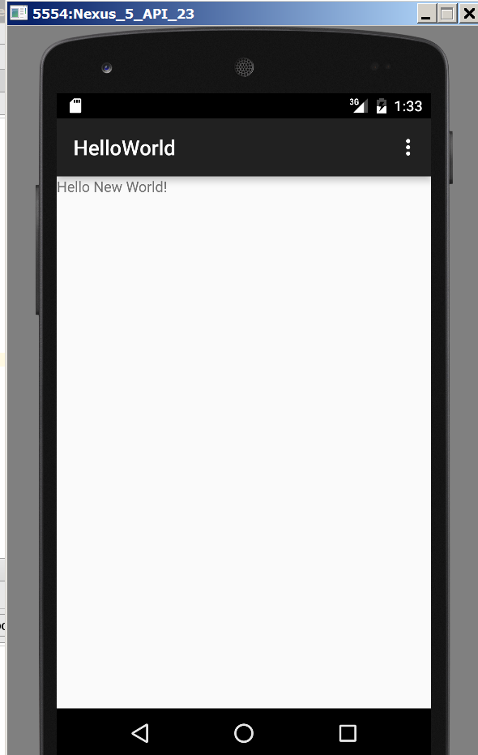

Slide 43
Lab 3

Slide 44
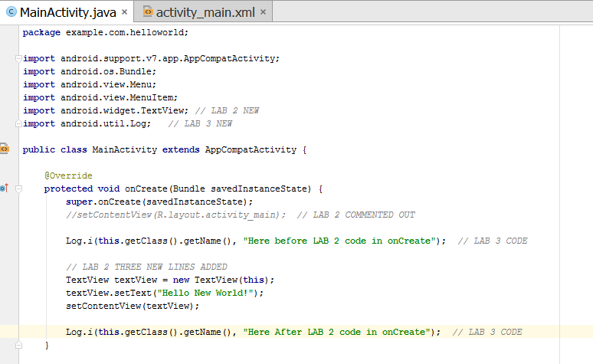
Change MainActivity.java to this

Slide 45
Lab 3 Changes to Lab 2 Code
Add to Import
import android.util.Log;
ADD THESE LINES to OnCreate Method
Log.i(this.getClass().getName(), “TEXT1");
TextView textView = new TextView(this); // 3 lines already exists from lab2
textView.setText("Hello New World!");
setContentView(textView);
Log.i(this.getClass().getName(), “TEXT2");

Slide 46
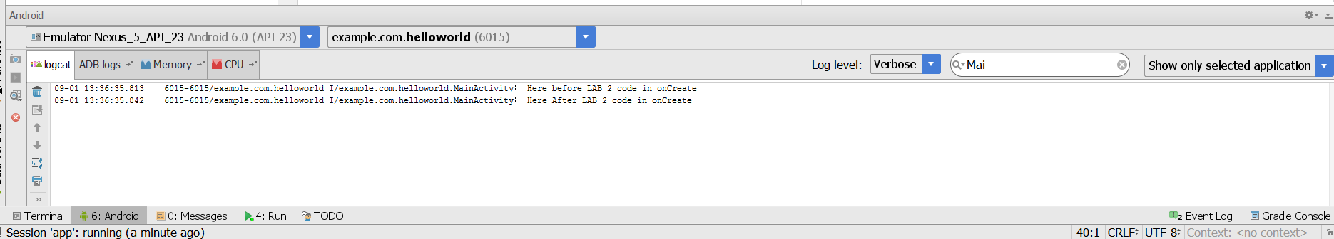
Run and Check the Logcat Filter

Slide 47
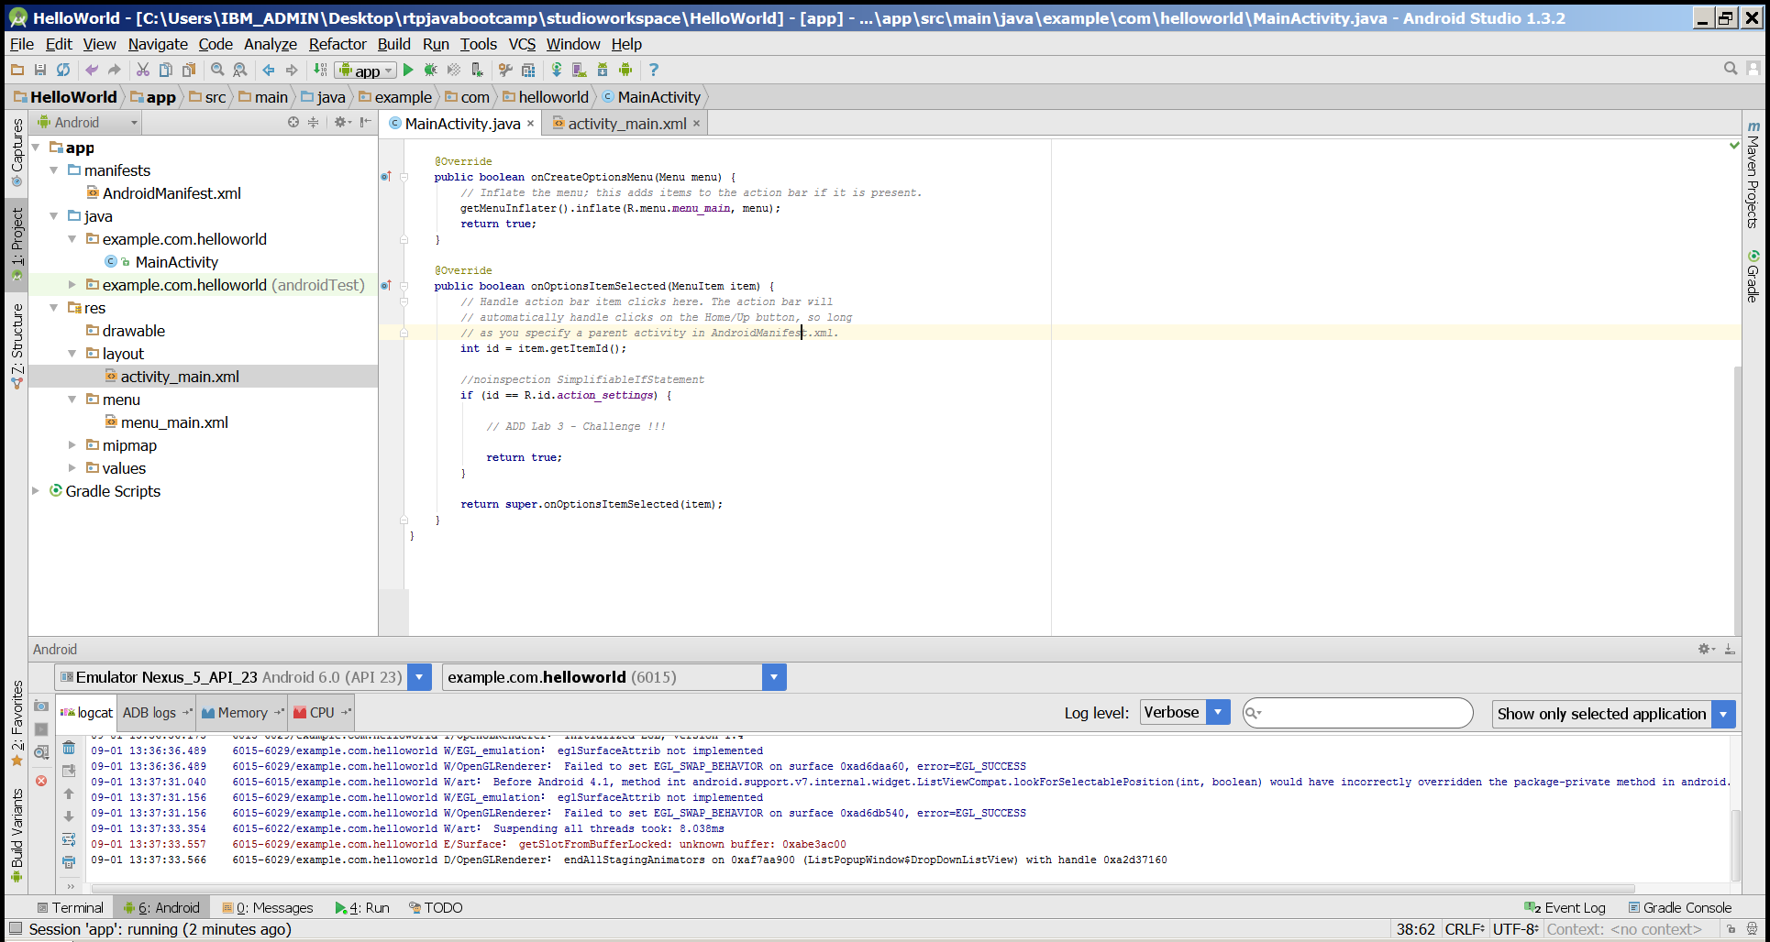
See if you can Find Method for Options Settings menu via Logging

Slide 48
Lab 4
Creating ERROR

Slide 49
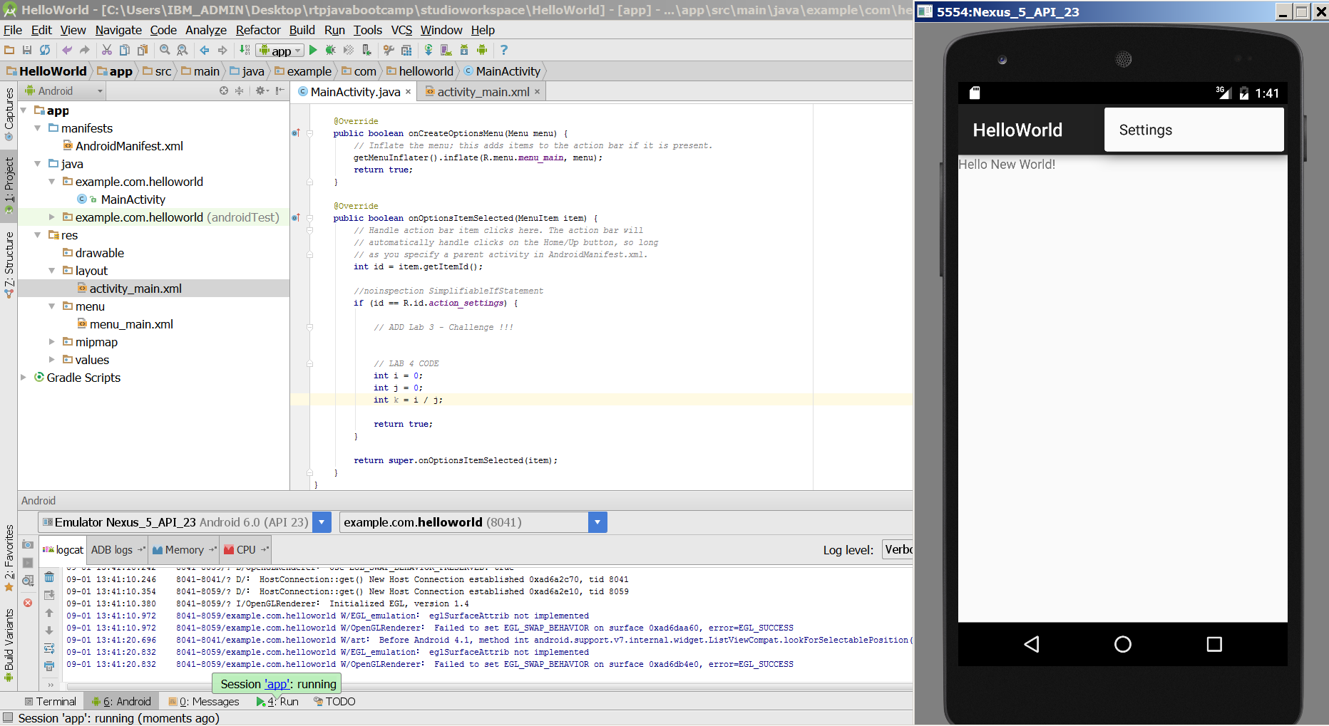
Lab 4 – MainActivity.java

Slide 50
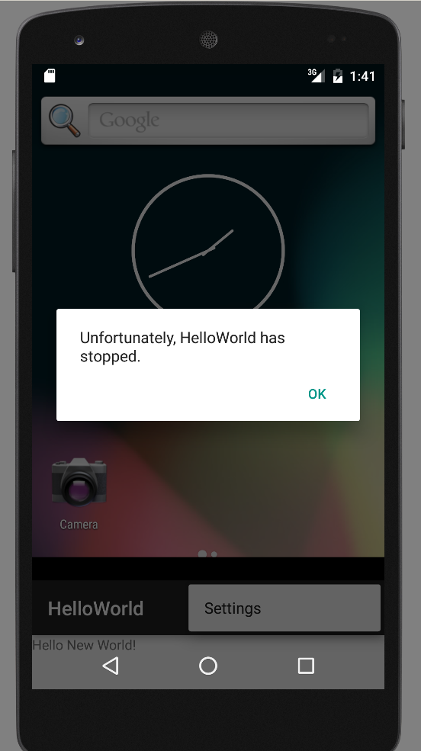
Error

Slide 51
Lab 5
Toasting

Slide 52
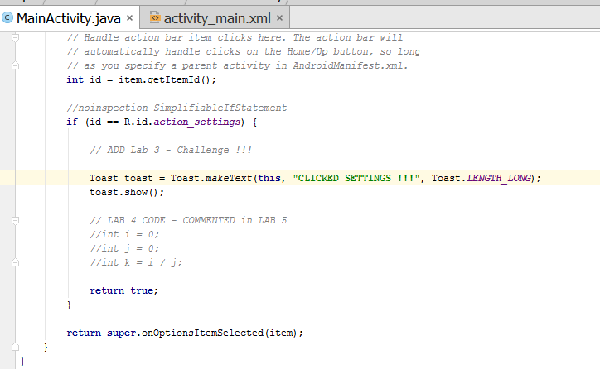
Change onOptionsSelectedItem Method

Slide 53
Lab 5 Changes to Lab 4 Code
Add to Import
import android.widget.Toast;
REMOVE – int Lines
ADD THESE LINES
Toast toast = Toast.makeText(this, "Created !!!", Toast.LENGTH_LONG);
toast.show();

Slide 54
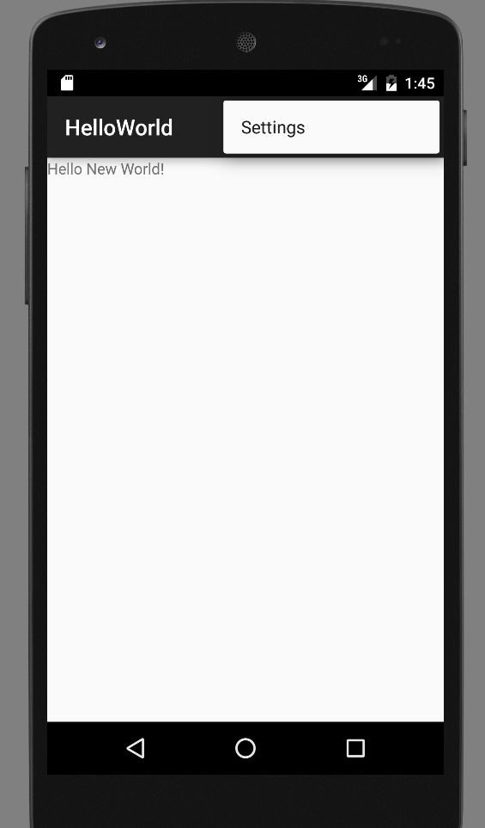
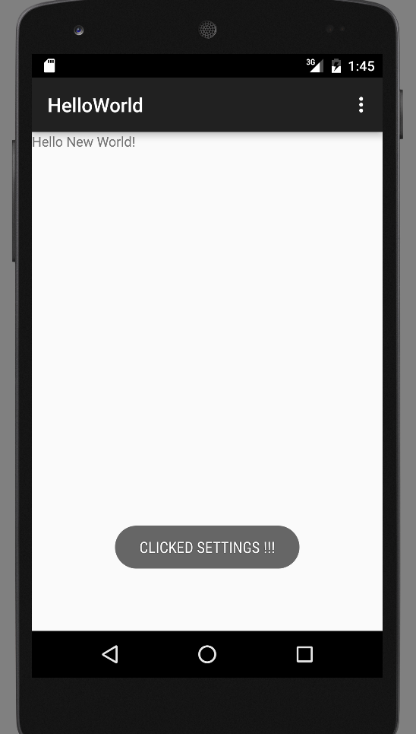

Slide 55
Lab 6

Slide 56
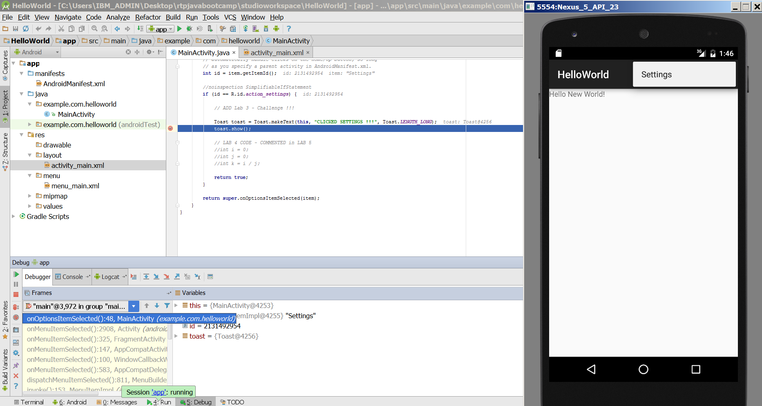
Adding DEBUG Breakpoint

Slide 57
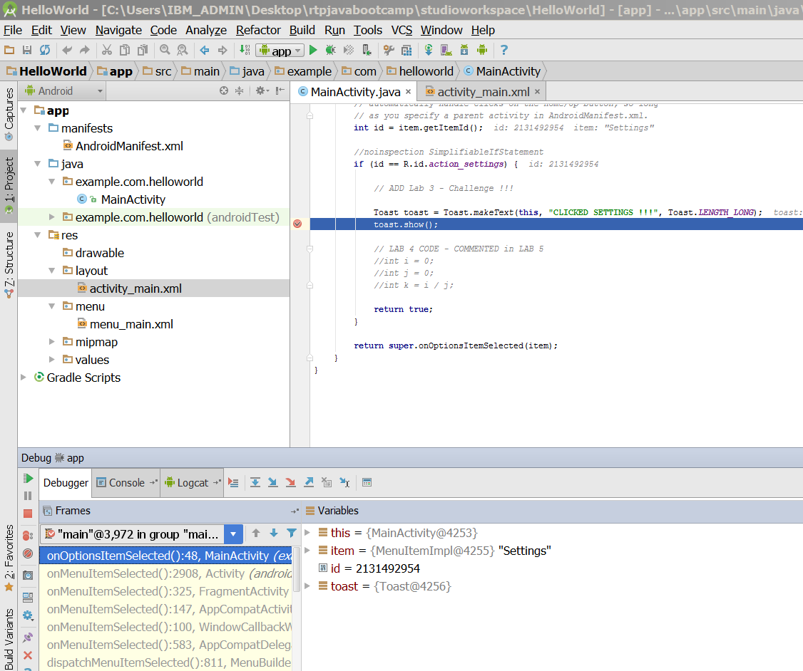
Debug Mode Screenshot

Slide 58
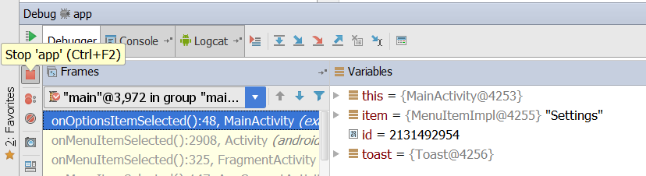
Stopping the Debbuger

Slide 59
Dalvik Debug Monitor Server
DDMS
debugging tool
"provides, screen capture on the device, thread and heap information on the device, logcat, process, and radio state information, incoming call and SMS spoofing, location data spoofing, and more."
can interact with DDMS via Eclipse plugin, another view in Eclipse

Slide 60
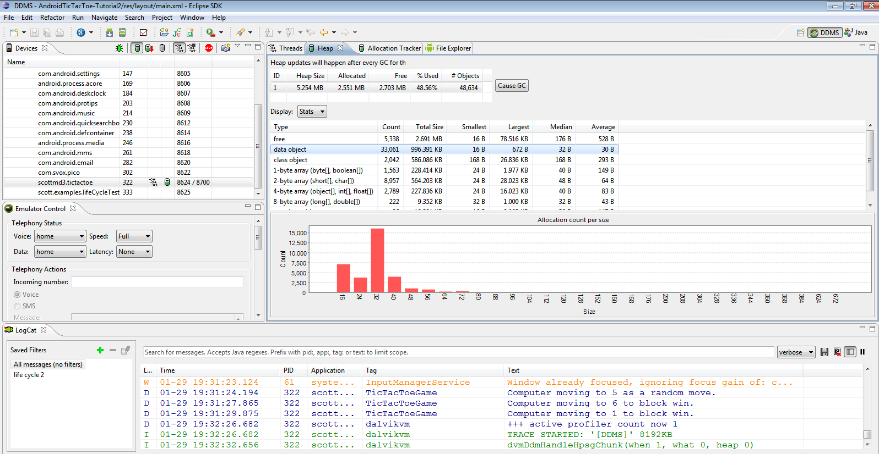
DDMS

Slide 61
Lab 7
Adding Button and OnClickEvent

Slide 62
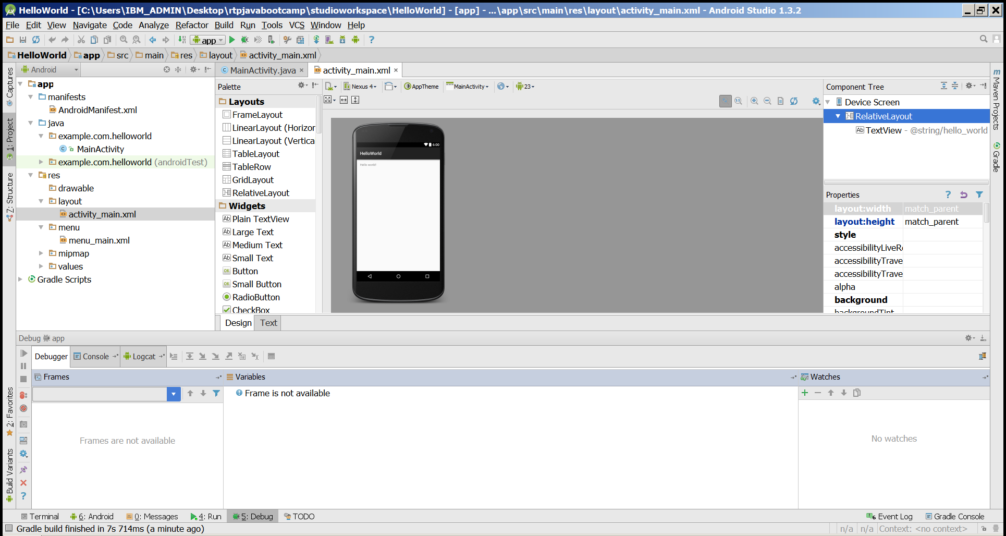
On Activity_main.xml - 1 add a button and change properties to Submit

Slide 63
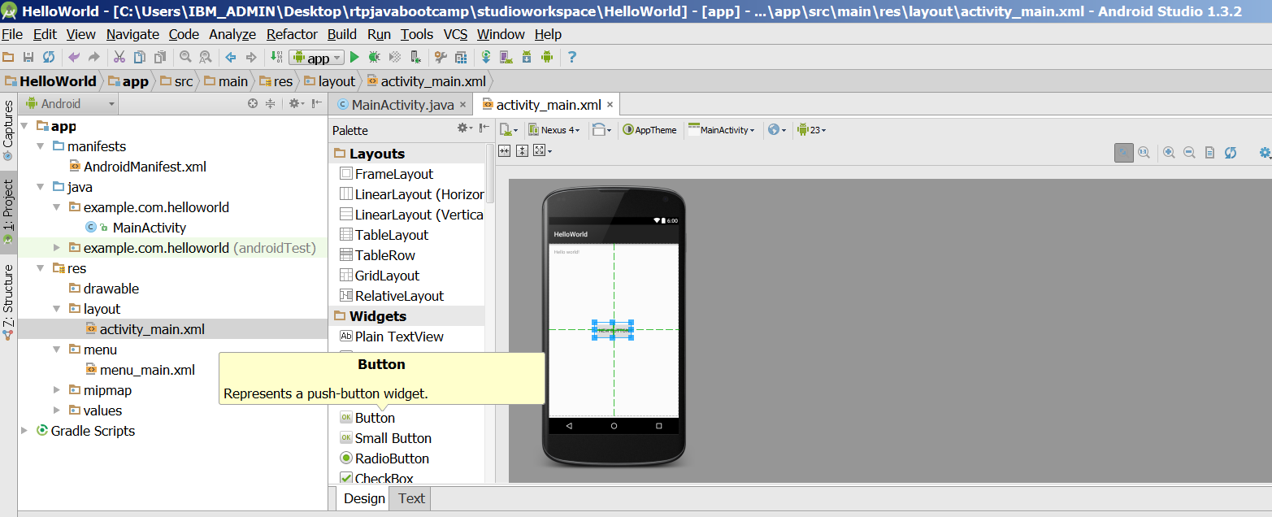
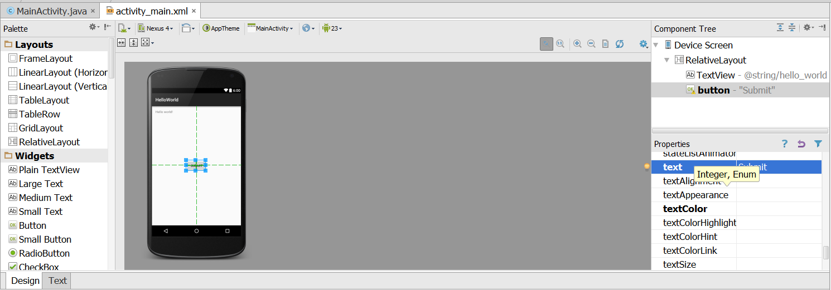
On Activity_main.xml - 2

Slide 64
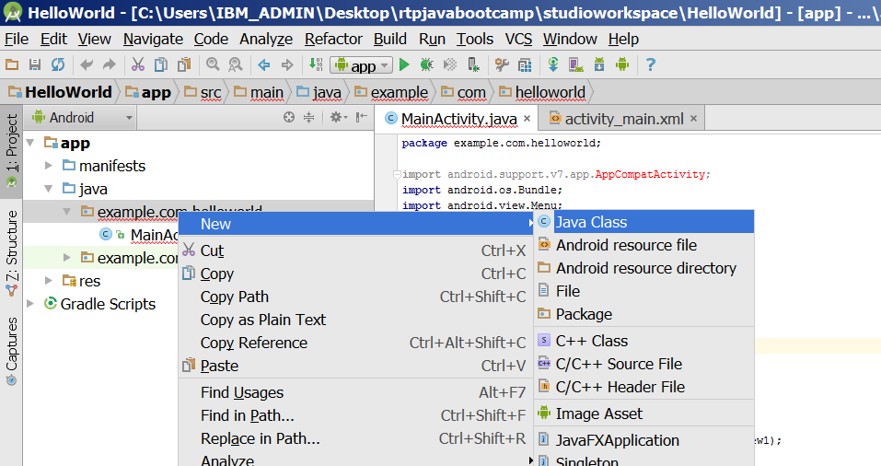
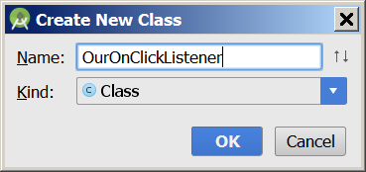
Create a new Java Class

Slide 65
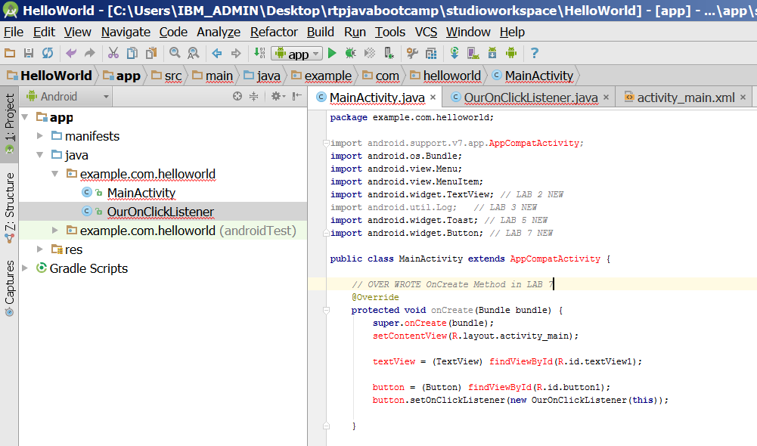
New OnCreate Method

Slide 66
New OnCreate Method
package com.example.helloandroid;
import android.app.Activity;
import android.os.Bundle;
import android.os.StrictMode;
import android.util.Log;
import android.view.Menu;
import android.view.MenuItem;
import android.widget.Button;
import android.widget.TextView;
import android.widget.Toast;
public class MainActivity extends AppCompatActivity {
TextView textView;
Button ourButton;
// OVER WRITE OnCreate Method in LAB 7
@Override
protected void onCreate(Bundle bundle) {
super.onCreate(bundle);
setContentView(R.layout.activity_main);
textView = (TextView) findViewById(R.id.textView);
ourButton = (Button) findViewById(R.id.button);
ourButton.setOnClickListener(new OurOnClickListener(this));
}
...

Slide 67
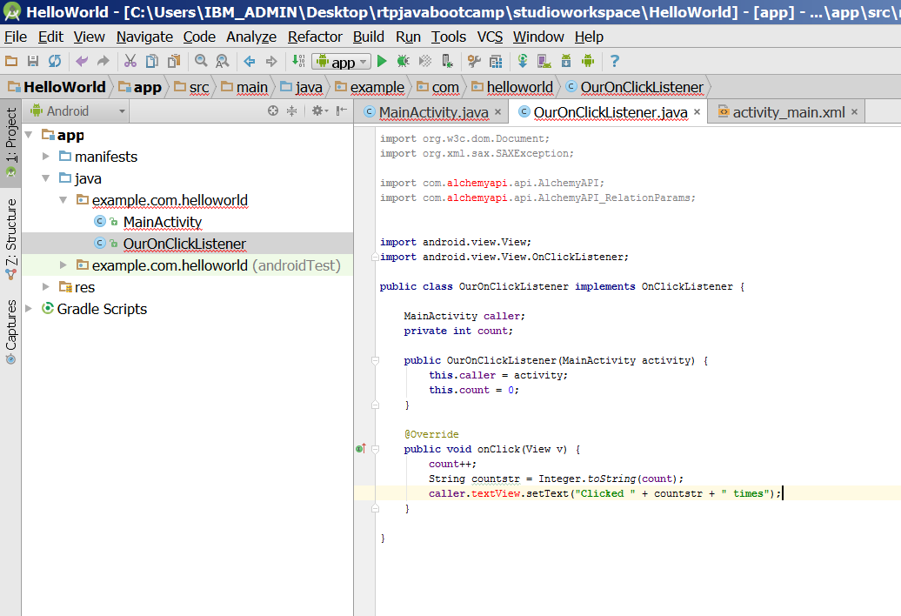
New OurOnClickListener Class

Slide 68
NEW CLASS CREATED IN LAB 7
package com.example.helloandroid;
import android.view.View;
import android.view.View.OnClickListener;
public class OurOnClickListener implements OnClickListener {
MainActivity caller;
private int count;
public OurOnClickListener(MainActivity activity) {
this.caller = activity;
this.count = 0;
}
@Override
public void onClick(View v) {
count++;
String countstr = Integer.toString(count);
caller.textView.setText("Clicked " + countstr + " times");
}
}

Slide 69
Important Files
src/MainActivity.java
Activity which is started when app executes
gen/R.java (DO NOT MODIFY!)
Auto-generated, auto-updated file with identifiers from main.xml, strings.xml, and elsewhere
res/layout/activity_main.xml
Defines & lays out widgets for the activity
res/values/strings.xml
String constants used by app
AndroidManifest.xml
Declares all the app’s components
Names libraries app needs to be linked against
Identifies permissions the app expects to be granted

Slide 70
1 - src/MainActivity.java
package com.example.helloworld;
import android.support.v7.app.AppCompatActivity;
import android.os.Bundle;
import android.view.Menu;
import android.view.MenuItem;
public class MainActivity extends AppCompatActivity {
@Override
protected void onCreate(Bundle savedInstanceState) {
super.onCreate(savedInstanceState);
setContentView(R.layout.activity_main);
}
@Override
public boolean onCreateOptionsMenu(Menu menu) {
// Inflate the menu; this adds items to the action bar if it is present.
getMenuInflater().inflate(R.menu.menu_main, menu);
return true;
}
@Override
public boolean onOptionsItemSelected(MenuItem item) {
// Handle action bar item clicks here. The action bar will
// automatically handle clicks on the Home/Up button, so long
// as you specify a parent activity in AndroidManifest.xml.
int id = item.getItemId();
//noinspection SimplifiableIfStatement
if (id == R.id.action_settings) {
return true;
}
return super.onOptionsItemSelected(item);
}
}

Slide 71
2 - gen/R.java
Auto-generated file with identifiers from main.xml, strings.xml, and elsewhere
/* AUTO-GENERATED FILE. DO NOT MODIFY. * * This class was automatically generated by the * aapt tool from the resource data it found. It * should not be modified by hand. */ package com.example.helloworld; public final class R { public static final class anim { public static final int abc_fade_in=0x7f050000; public static final int abc_fade_out=0x7f050001; public static final int abc_grow_fade_in_from_bottom=0x7f050002; public static final int abc_popup_enter=0x7f050003; public static final int abc_popup_exit=0x7f050004; public static final int abc_shrink_fade_out_from_bottom=0x7f050005; public static final int abc_slide_in_bottom=0x7f050006; public static final int abc_slide_in_top=0x7f050007; public static final int abc_slide_out_bottom=0x7f050008; public static final int abc_slide_out_top=0x7f050009; } public static final class attr { /** <p>Must be a reference to another resource, in the form "<code>@[+][<i>package</i>:]<i>type</i>:<i>name</i></code>" or to a theme attribute in the form "<code>?[<i>package</i>:][<i>type</i>:]<i>name</i></code>".
Do not modify!

Slide 72
3 - res/layout/activity_main.xml
<RelativeLayout xmlns:android="http://schemas.android.com/apk/res/android"
xmlns:tools="http://schemas.android.com/tools" android:layout_width="match_parent"
android:layout_height="match_parent" android:paddingLeft="@dimen/activity_horizontal_margin"
android:paddingRight="@dimen/activity_horizontal_margin"
android:paddingTop="@dimen/activity_vertical_margin"
android:paddingBottom="@dimen/activity_vertical_margin" tools:context=".MainActivity">
<TextView android:text="@string/hello_world" android:layout_width="wrap_content"
android:layout_height="wrap_content"
android:id="@+id/textView" />
<Button
android:layout_width="wrap_content"
android:layout_height="wrap_content"
android:text="Submit"
android:id="@+id/button"
android:layout_below="@+id/textView"
android:layout_toRightOf="@+id/textView"
android:layout_toEndOf="@+id/textView"
android:layout_marginTop="68dp" />
</RelativeLayout>

Slide 73
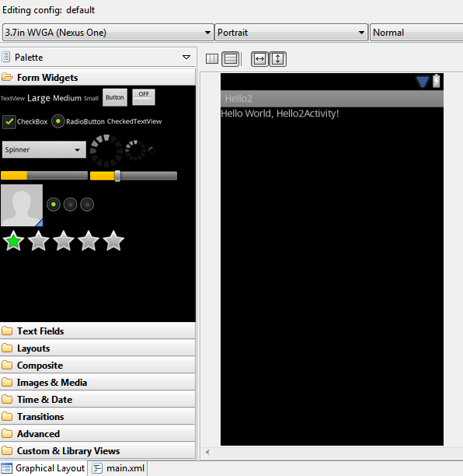
3 contd. - Layout could be complex

Slide 74
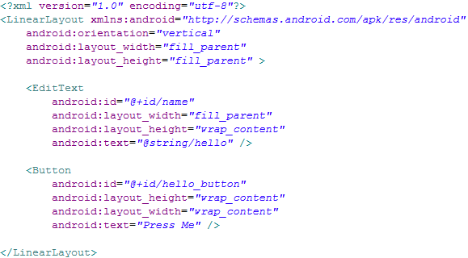
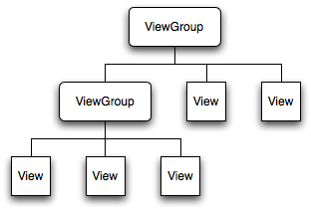
3 contd. - Understanding Layout
Declares layouts & widgets for the activity
Tree from: http://developer.android.com/guide/topics/ui/index.html
Notes:
A ViewGroup is a special view that can contain other views (called children.) The view group is the base class for layouts and views containers. The ViewGroup subclass is the base class for layouts, which are invisible containers that hold other Views (or other ViewGroups) and define their layout properties. LinearLayout is a subclass of ViewGroup.
The View class represents the basic building block for user interface components. A View occupies a rectangular area on the screen and is responsible for drawing and event handling. View is the base class for widgets, which are used to create interactive UI components (buttons, text fields, etc.).

Slide 75
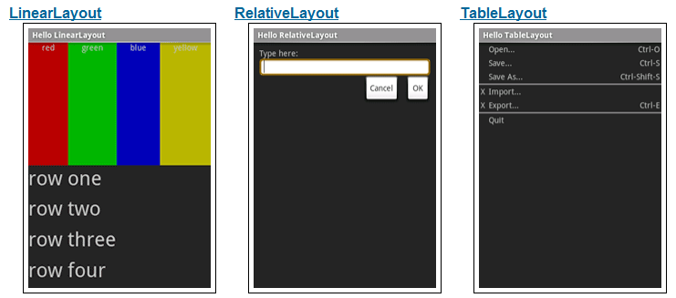
3 Contd - Available Layouts
http://developer.android.com/resources/tutorials/views/index.html

Slide 76
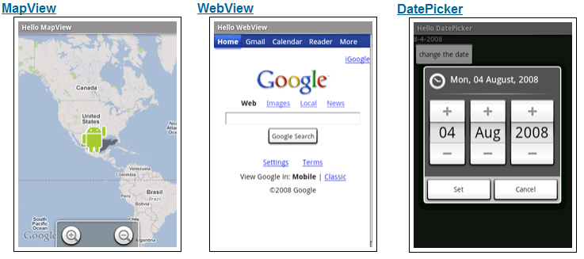
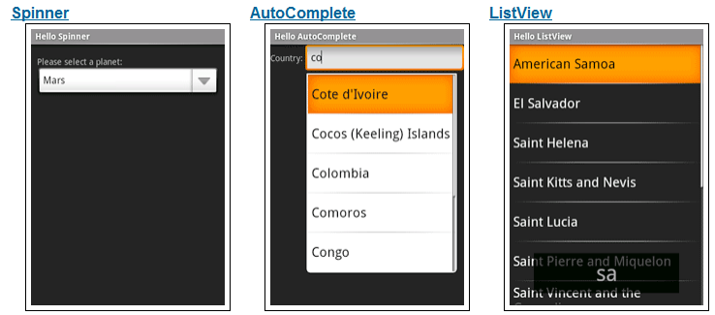
3 Layout and Available Widgets
http://developer.android.com/resources/tutorials/views/index.html

Slide 77
4 - res/values/strings.xml
String constants used by app
Used for supporting Localization
res/values-es/values/strings.xml to support Spanish
res/values-fr/values/strings.xml to support French
Etc.
<resources> <string name="app_name">HelloWorld</string> <string name="hello_world">Hello world!</string> <string name="action_settings">Settings</string> </resources>

Slide 78
5 - AndroidManifest.xml
Declares all the app’s components
Names libraries app needs to be linked against
Identifies permissions the app expects to be granted
<?xml version="1.0" encoding="utf-8"?> <manifest xmlns:android="http://schemas.android.com/apk/res/android" package="com.example.helloworld" > <application android:allowBackup="true" android:icon="@mipmap/ic_launcher" android:label="@string/app_name" android:theme="@style/AppTheme" > <activity android:name=".MainActivity" android:label="@string/app_name" > <intent-filter> <action android:name="android.intent.action.MAIN" /> <category android:name="android.intent.category.LAUNCHER" /> </intent-filter> </activity> </application> </manifest>
Notes:
This is the most common IntentFilter seen in Android applications. The action android.intent.action.MAIN indicates that this is the first activity that should be executed when starting this app. The category android.intent.category.LAUNCHER places this Activity in
the launcher window (the window that lists all the available apps).

Slide 79
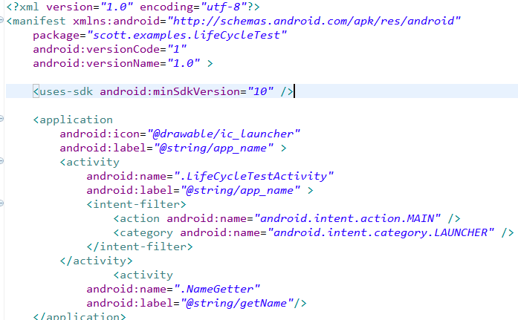
5 contd - AndroidManifest.xml
All Activities that are part of application must be registered in Manifest
Specify Activity to start with
Notes:
This is the most common IntentFilter seen in Android applications. The action android.intent.action.MAIN indicates that this is the first activity that should be executed when starting this app. The category android.intent.category.LAUNCHER places this Activity in
the launcher window (the window that lists all the available apps).

Slide 80
Some other topics covered
onCreate() in Activity
Adding Text and Changing Properties from Code
Use the log to v, d, i, w, e
VERBOSE, DEBUG, INFO, WARN, ERROR
Create a TAG so we can filter
Toast a message
Debug BreakPoint
ScreenShot of the APP
Adding component
Adding an Event and Setting Properties

Slide 81
References
Android Dev Guide http://developer.android.com/guide/topics/fundamentals.html
http://developer.android.com/guide/topics/fundamentals/activities.html

